Slide 1
Kernels and Regularization on Graphs
Literature review 03
Notes:
This paper
1) introduce a family of kernels on graphs based on the notion of regularization operators
2) developed the regularization theory of learning on graphs using kernels and explored methods for efficiently computing and approximating the kernel matrix.
What does the paper research on Kernel
the canonical family of kernels on graphs are of the form of power series in the graph Laplacian.
such kernels can be characterized by a real valued function of the eigenvalues of the Laplacian.
The meaning of kernel:

Slide 2
Contents
1
Basic definitions
2
Regularization on graph

Slide 3
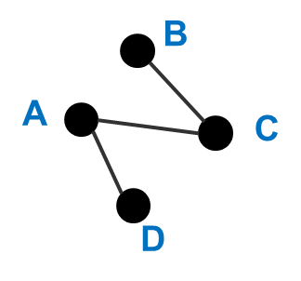

1 Basic definition
Review on graph
$$Undirected unweighted graph:G$$

Slide 4
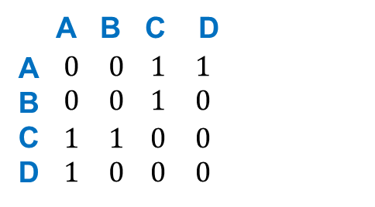
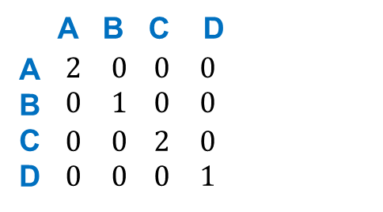

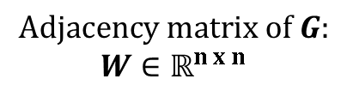
1 Basic definition
Review on graph
$$Degree matrix of G:$$
$$D∈ℝ^{n x n} D_{ii}=\sum_{j}{W_{ij}}$$
$$Undirected unweighted graph:G$$
$$Adjacency matrix of G:$$
$$W∈ℝ^{n x n}$$

Slide 5
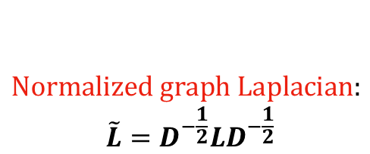
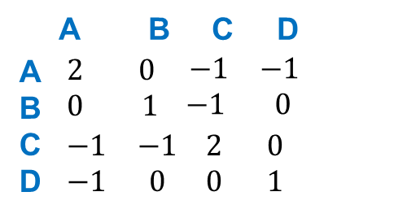
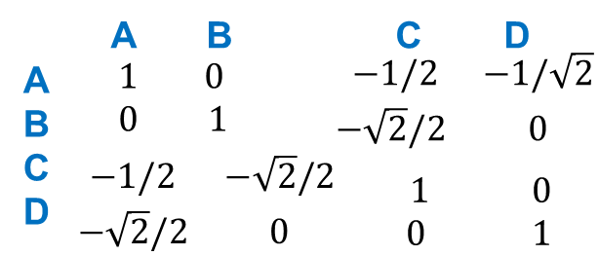
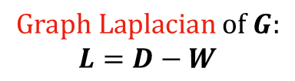
1 Basic definition
Review on graph
$$Degree matrix of G:$$
$$D∈ℝ^{n x n} D_{ii}=\sum_{j}{W_{ij}}$$
$$Undirected unweighted graph:G$$
$$Adjacency matrix of G:$$
$$W∈ℝ^{n x n}$$
$$Normalized graph Laplacian:$$
$$\tilde{L}=D^{−\frac{1}{2}}LD^{−\frac{1}{2}}$$
$$Graph Laplacian of G:$$
$$L=D−W$$

Slide 6

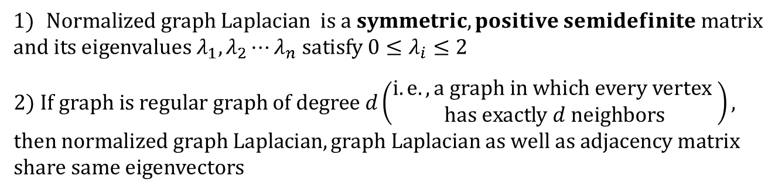
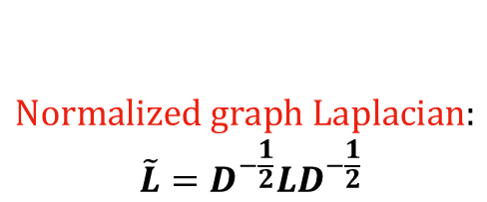
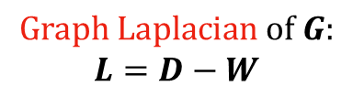
1 Basic definition
Review on spectral graph theory
$$Normalized graph Laplacian:$$
$$\tilde{L}=D^{−\frac{1}{2}}LD^{−\frac{1}{2}}$$
Foundation of spectral graph theory
$$Graph Laplacian of G:$$
$$L=D−W$$
Two well-know theorem

Slide 7
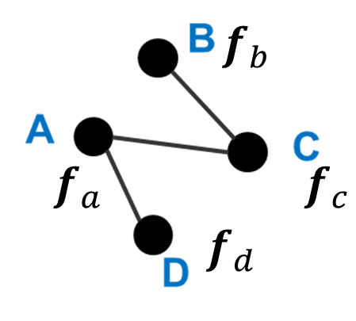
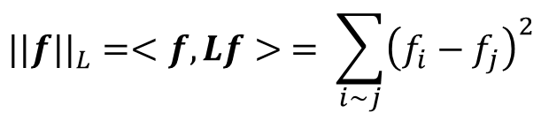
1 Basic definition
Review on spectral graph theory
$$Normalized graph Laplacian:$$
$$\tilde{L}=D^{−\frac{1}{2}}LD^{−\frac{1}{2}}$$
Foundation of spectral graph theory
$$Graph Laplacian of G:$$
$$L=D−W$$
Graph Laplacian and Normalized graph Laplacian can act as linear operators on function or a vector.
$$If function or vector f is deined on graph$$
$${||f||}_{L}=<f,Lf> = \sum_{i\sim j}{{\left(f_{i}−f_{j}\right)}^{2}}$$
Notes:
Quantify how smooth they are over their respective domains

Slide 8
1 Basic definition
Review on spectral graph theory
$$Normalized graph Laplacian:$$
$$\tilde{L}=D^{−\frac{1}{2}}LD^{−\frac{1}{2}}$$
Foundation of spectral graph theory
$$Graph Laplacian of G:$$
$$L=D−W$$
Graph Laplacian and Normalized graph Laplacian can act as linear operators on function or a vector.
$$If function or vector f is deined on graph$$
$${||f||}_{L}=<f,Lf> = \sum_{i\sim j}{{\left(f_{i}−f_{j}\right)}^{2}}$$
Regularization
The semi norm on f by graph Laplacian penalizes changes on adjacent vertices
Notes:
The semi norm on f by graph Laplacian penalizes changes on adjacent vertices, which can be utilized for regularization goal
Before we go deep into regularization via graph Laplacian, we first have a brief review on regularization operators and cooresponding kernel presentation

Slide 9



2 Regularization on Graph
Define the regularization of f as:
Where

Slide 10

2 Regularization on Graph
Define the regularization of f as:
Where

Slide 11
2 Regularization on Graph
Define the regularization of f as:
Where

Slide 12
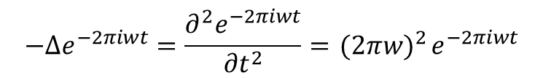

2 Regularization on Graph
Define the regularization of f as:
Where
Noted:
$$\left\{<ψ_{i},λ_{i}>\right\} is the eigensystem of ∆$$
because:
$$−∆e^{−2πiwt}=\frac{∂^{2}e^{−2πiwt}}{{∂t}^{2}}={ (2πw)}^{2}e^{−2πiwt}$$

Slide 13

2 Regularization on Graph
Define the regularization of f as:
Where
Noted:
because:
Eigen value and Eigen vector show up!
$$Ax=λx$$

Slide 14
2 Regularization on Graph
Define the regularization of f as:
Where
Sift the information based on the eigen-vector by sifting the orthogonal ones.
Noted:
because:
Eigen value and Eigen vector show up!
$$Ax=λx$$

Slide 15
2 Regularization on Graph
Define the regularization of f as:
Where
Penalize the information according to the eigenvalue
Noted:
because:
Eigen value and Eigen vector show up!
$$Ax=λx$$

Slide 16
2 Regularization on Graph
Define the regularization of f as:
Where
Thus the construction of $r\left(.\right)$ has relationship with the regularization form

Slide 17
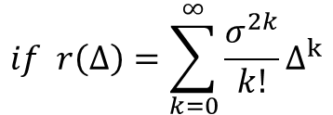
2 Regularization on Graph
Define the regularization of f as:
Where
Thus the construction of $r\left(.\right)$ has relationship with the regularization form
$$if r\left(Δ\right)=\sum_{k=0}^{∞}{\frac{σ^{2k}}{k!}∆^{k}}$$

Slide 18
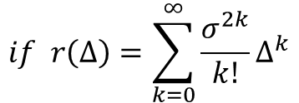
2 Regularization on Graph
Define the regularization of f as:
Where
Thus the construction of $r\left(.\right)$ has relationship with the regularization form
$$if r\left(Δ\right)=\sum_{k=0}^{∞}{\frac{σ^{2k}}{k!}∆^{k}}$$
From
Notes:
Apply r on sanjiao equals apply r on eigenvalue of sanjiao in latter one

Slide 19
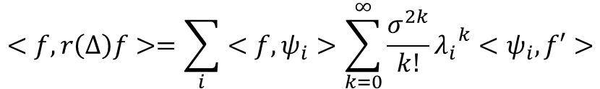
2 Regularization on Graph
Define the regularization of f as:
Where
Thus the construction of $r\left(.\right)$ has relationship with the regularization form
We have

Slide 20
2 Kernels and Regularization on Graph
Define the regularization of f as:
Where
Thus the construction of $r\left(.\right)$ has relationship with the regularization form
$$if r\left(Δ\right)=\sum_{k=0}^{∞}{\frac{σ^{2k}}{k!}∆^{k}}$$
We have

Slide 21
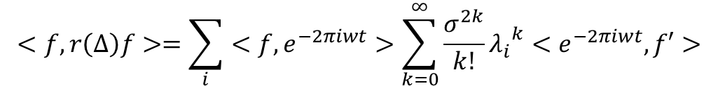
2 Regularization on Graph
Define the regularization of f as:
Where
Thus the construction of $r\left(.\right)$ has relationship with the regularization form
$$if r\left(Δ\right)=\sum_{k=0}^{∞}{\frac{σ^{2k}}{k!}∆^{k}}$$
We have

Slide 22
2 Regularization on Graph
Define the regularization of f as:
Where
Thus the construction of $r\left(.\right)$ has relationship with the regularization form
$$if r\left(Δ\right)=\sum_{k=0}^{∞}{\frac{σ^{2k}}{k!}∆^{k}}$$
We have
Fourier transform is hidden here!

Slide 23
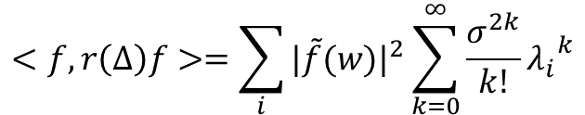
2 Regularization on Graph
Define the regularization of f as:
Where
Thus the construction of $r\left(.\right)$ has relationship with the regularization form
$$if r\left(Δ\right)=\sum_{k=0}^{∞}{\frac{σ^{2k}}{k!}∆^{k}}$$
We have

Slide 24
2 Regularization on Graph
Define the regularization of f as:
Where
Thus the construction of $r\left(.\right)$ has relationship with the regularization form
$$if r\left(Δ\right)=\sum_{k=0}^{∞}{\frac{σ^{2k}}{k!}∆^{k}}$$
We have
$$<f,r\left(Δ\right)f>=\sum_{i}{{|\tilde{f}(w)|}^{2}\sum_{k=0}^{∞}{\frac{σ^{2k}}{k!}{λ_{i}}^{k}}}$$

Slide 25

2 Regularization on Graph
Define the regularization of f as:
Where
Thus the construction of $r\left(.\right)$ has relationship with the regularization form
$$if r\left(Δ\right)=\sum_{k=0}^{∞}{\frac{σ^{2k}}{k!}∆^{k}}$$
We have
$$<f,r\left(Δ\right)f>=\sum_{i}{{|\tilde{f}(w)|}^{2}\sum_{k=0}^{∞}{\frac{σ^{2k}}{k!}{λ_{i}}^{k}}}$$

Slide 26
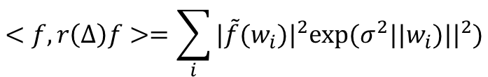
2 Regularization on Graph
Define the regularization of f as:
Where
Thus the construction of $r\left(.\right)$ has relationship with the regularization form
We have

Slide 27
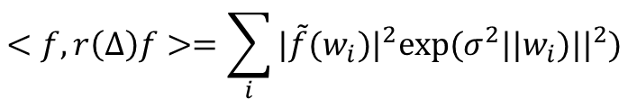
2 Regularization on Graph
Define the regularization of f as:
Where
Thus the construction of $r\left(.\right)$ has relationship with the regularization form
We have
$$<f,r\left(Δ\right)f>=\sum_{i}{{|\tilde{f}(w_{i})|}^{2}exp⁡(σ^{2}{||w_{i})||}^{2})}$$
Such definition of $r\left(Δ\right)$ leads to Gaussian RBF kernel on regularization!
Notes:
Now we go back to regularization on graph

Slide 28

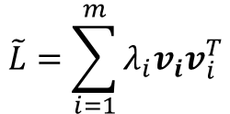
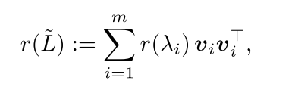
2 Kernels and Regularization on Graph
Define the regularization of f as:
Where
Similarly, regularization function on graph can be defined:
Where
SVD
Notes:
Now we go back to regularization on graph
Here r(˜L) is understood as applying the scalar valued function r(λ) to the eigen- values of ˜L, that is,

Slide 29
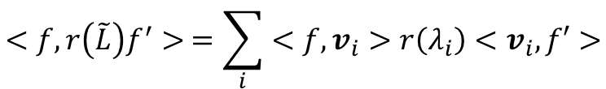

2 Kernels and Regularization on Graph
Define the regularization of f as:
Where
Similarly, regularization function on graph can be defined:
Regularization via Graph Laplacian
Where
SVD
Notes:
Now we go back to regularization on graph
Here r(˜L) is understood as applying the scalar valued function r(λ) to the eigen- values of ˜L, that is,

Slide 30
2 Regularization on Graph
Define the regularization of f as:
Where
Similarly, regularization function on graph can be defined:
The choice of $r(.)$ determines how we regularize the function defined on the graph.
Notes:
Now we go back to regularization on graph
Here r(˜L) is understood as applying the scalar valued function r(λ) to the eigen- values of ˜L, that is,

Slide 31
2 Regularization on Graph
Define the regularization of f as:
Where
Similarly, regularization function on graph can be defined:
The choice of $r(.)$ determines how we regularize the function defined on the graph.
Small eigen values of the graph Laplacian have associated eigen-vectors which vary little between adjacent vertices
Notes:
Now we go back to regularization on graph
Here r(˜L) is understood as applying the scalar valued function r(λ) to the eigen- values of ˜L, that is,

Slide 32
Thank you for attention !

Slide 33
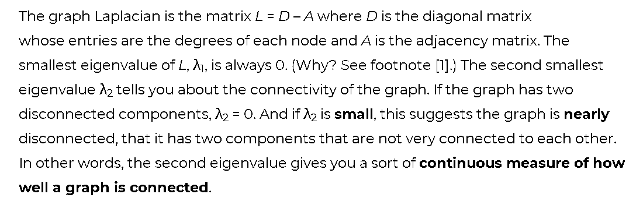
2 Kernels and Regularization on Graph
Notes:
Now we go back to regularization on graph
Here r(˜L) is understood as applying the scalar valued function r(λ) to the eigen- values of ˜L, that is,

